Slide 1

Journey of Jet Airways
Presented by:
Group 3
Dhairya Manish Chawda (B2021017)
Harshita Khandelwal (B2021020)
Keshav Raj (B2021022)
Nishant Keswani (B2021028)
Shiwang Agarwal (B2021041)
Uddeshya harsh (B2021052)
Subject: Business economics
Faculty: Dr. Chinmaya Behera

Slide 2
Business all about
Rise & Fall
2016
Jet Airways is one of the largest airlines in India, with a 21.2% passenger market share in February.
25 March 2019
Mr. Naresh & Anita Goyal stepped down from the board of directors with 1/4th aircrafts grounded.
17th June 2019
Applied to NCLT for bankruptcy proceedings with debt of $1.2 billion.
2018
Jet Airways has been reported to have a negative financial outlook due to increasing losses.
April 2019
Indian Oil Corporation stopped supplying fuel to the airline, and all flight operations were suspended.
2021
Jet Airways Ltd is planning a revival in partnership with Kalrock Capital and MurariLal Jalan with full operational capacity by 2022.

Slide 3
Consumer all about
Market Segmentation
Based on Salary
Based on Operations
First Class
Premium Class
Economy Class
Cost Segmentation
First Time Travellers
Customer Retention
Based on Distance
Distance | Price(₹)
Up to 750 Km | 2250
From 750 Km to 1000 Km | 2850
From 1000 Km to 1400 Km | 3300
Beyond 1400 Km | 3800

Slide 4
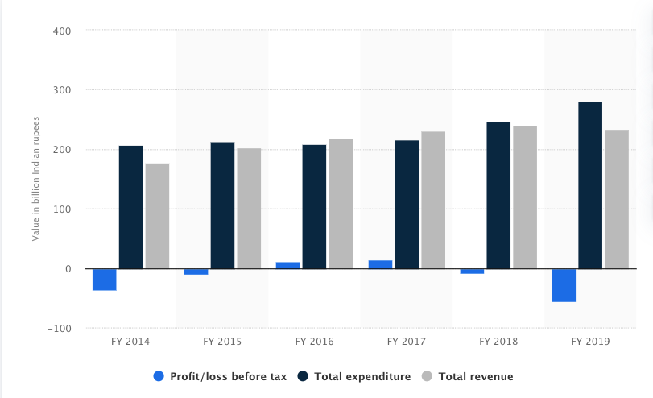
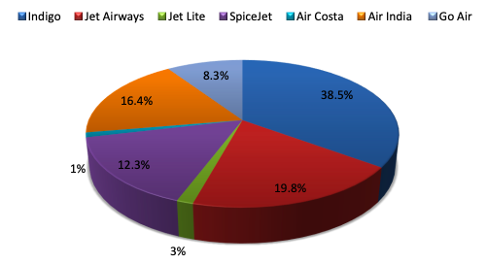
Statistical Functioning
Market Share of Limited Liability Company
Domestic Market Domination
Year on Year Revenue
Induction of Loss Period (Load Analysis)
What happened (Fair Strategy)

Slide 5
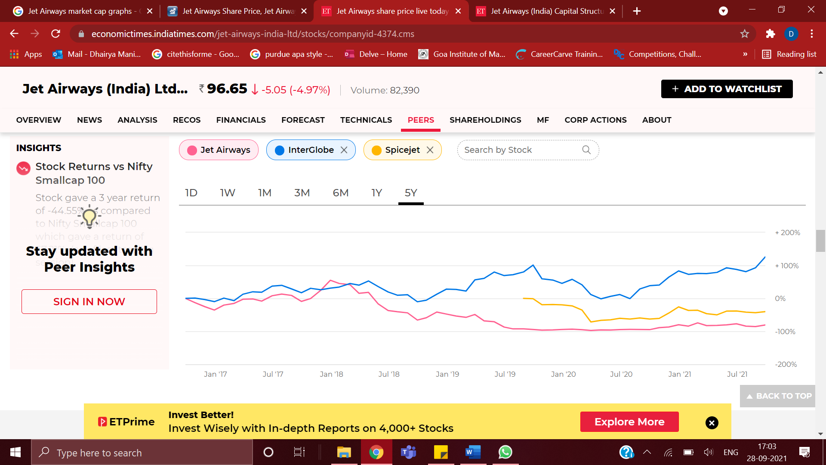
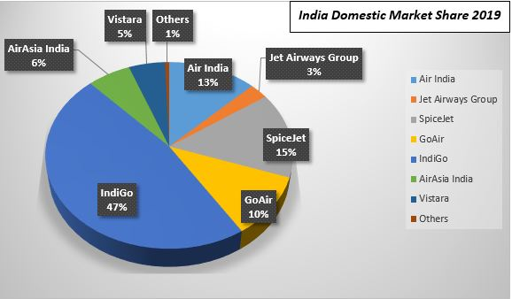
Market functioning
Market Capture
Market Metrics
Function Reasoning

Slide 6

Swot analysis
Strengths
Decent Company Image with a wide employee base.
One of the biggest domestic flight network.
Exemplary Marketing and Customer Service.
Weaknesses
Growing Competition from other Airlines (LCC )
Route Cannibalization
Tarnished Image
Grass Root Re-establishment.
Oppurtunities
Segment Categorization on Customer presence
Strong Global Branding
Increasing Customer Base
Threats
LCCs consuming entire market share
Rising Fuel & Labor Costs
Aviation Regulations
Unfavorable Government Policies.

Slide 7
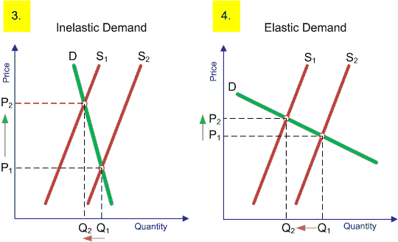
Reason for failure
Chairman’s Management Style
Underestimated low price model
Increased in oil prices
Failed to Find Strategic investor
Costly purchase

Slide 8
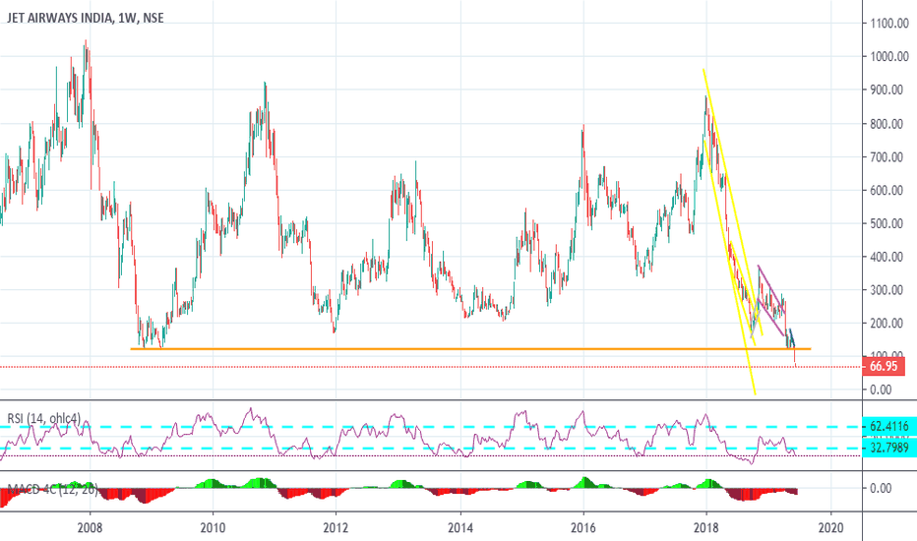
Reason for failure
Reason for failure
International Air Transport Association analysis on the aviation market from 2010-2013
2011 => Good growth in market capitalization but profits were not increasing.
2012 => Jet Lite shutdown.
2012 => Jet Konnect Launched
Opening of Jet Konnect was a good initiative as it created a good image of company in minds of people as the company is investing on others company means it is good company but actually the reason was different and the result we see sudden increase in their profit as well as their market capitalization.

Slide 9
Corrective measures
Current Action Taken
Jet Airways’ creditors have approved a resolution plan submitted by a consortium of UK-based Kalrock Capital and UAE-based businessman Murari Lal Jalan.
Expected Resumption of Operations
An approval for the resolution plan from the National Company Law Tribunal (NCLT). The new investors are said to be looking at investing Rs 1,000 crore into Jet Airways.
Major Concerns (Before Revival)
It will be important for Jet Airways to get hold of some of its prime slots to ensure sustainable operations, it is unlikely that other domestic airlines will let go of the slots without a fight.
Boarding Cleared (TakeOff to be scheduled)
Almost 2 years of proceeding at NCLT
Jet 2.0 will start with a clean slate.

Slide 10
Thank You

